Slide 1

FINIXTRA
Unified FinTech for the Modern World
Secure payments · AI insights · Fraud detection · All in one platform

Slide 2


fINIXTRA
Presented By:
Sayeda Irfat Jahan Tithi-(38)
Md. Mushfiqur Rahman-(22)
Md. Shahadat Hossen Shuvo-(17)
PRESENTED TO:
MD. ALAMGIR HOSSAIN, LECTURER

Slide 3
Introduction
Digital finance is changing money management
Existing apps are fragmented
FinTrix unifies payments, tracking & insights

Slide 4
Literature Review
Area | Existing Systems / Technologies | Key Limitation / Insight
Digital Wallets | PayPal, Google Pay, bKash | Limited to payments, weak financial analytics
Finance Management Apps | Mint, YNAB | Strong budgeting but no direct transaction support
Security Technologies | OAuth 2.0, JWT | Ensure authentication but not full system security alone
System Architecture | Microservices Architecture | Improves scalability and modularity in modern apps
AI & Machine Learning | Fraud detection models | Enables anomaly detection and predictive insights
Analytics & Personalization | Real-time analytics systems | Improves decision-making and user engagement

Slide 5
Problem Statement
Fragmented financial systems
Lack of deep analytics in wallets
Manual data entry in finance apps
Reactive security systems

Slide 6
Motivation
Improve financial visibility
Reduce fraud risk
Provide intelligent decision support
Build a unified financial platform

Slide 7
Objectives
Develop secure & scalable digital wallet
Automate expense categorization
Provide AI-based predictions & recommendations
Enable offline-first functionality
Ensure strong security

Slide 8
Expected Outcomes
Improved financial awareness
Reduced fraud
Seamless user experience
Personalized financial insights

Slide 9
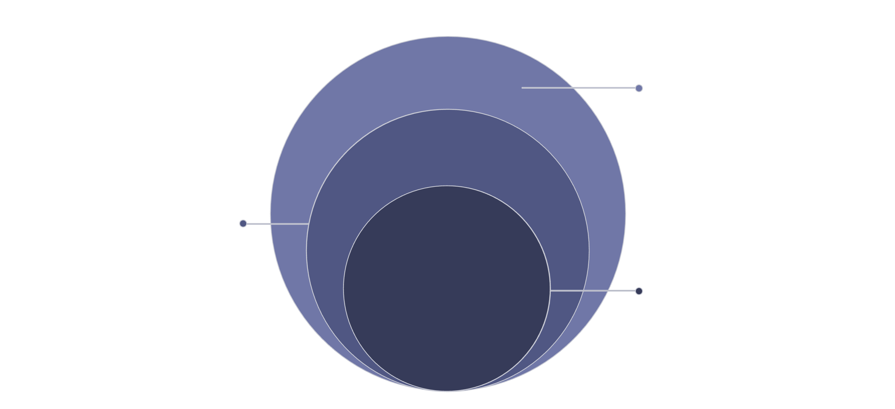
Proposed Methodology
AI & Data
Python ML models; PostgreSQL / MongoDB
Backend
Node.js & Spring Boot services
Frontend
Flutter / React client apps
Microservices-based, event-driven design with Kafka/RabbitMQ message brokers, JWT authentication, end-to-end encryption, and offline-first data synchronization.

Slide 10
Proposed Methodology
JWT authentication
Event-driven architecture
ML-based anomaly detection
Offline-first synchronization
End-to-end encryption

Slide 11

References
PayPal Developer Documentation
Google Pay API Documentation
IEEE FinTech Papers
OWASP Mobile Security Guidelines
PostgreSQL & Node.js Documentation

Slide 12
Thank You

